Slide 1
Structure Prediction
Rosetta 2025 ML Bootcamp
Ian Anderson
Slides originally by Nick Randolph in 2024

Slide 2
What is structure prediction?

Slide 3
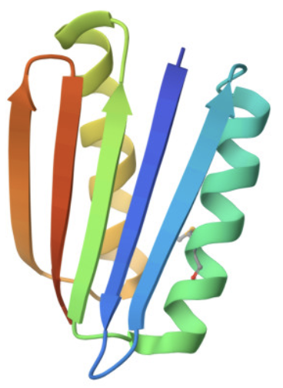
What is structure prediction?
Given the linear amino acid sequence of a polypeptide, what is the 3D structure?
Sequence
Structure
MGDIQVQVNIDDNGKNFDYTYTVTTESELQKVLNELMDYIKKQGAKRVRISITARTKKEAEKFAAILIKVFAELGYNDINVTFDGDTVTVEGQLEGGSLEHHHHHH

Slide 4
Following Anfinsen and Levinthal down the funnel
Anfinsen’s dogma (or thermodynamic hypothesis) (1960s):
The native structure is at a free energy minimum

Slide 5
Following Anfinsen and Levinthal down the funnel
Anfinsen’s dogma (or thermodynamic hypothesis) (1960s):
The native structure is at a free energy minimum
Levinthal’s paradox:
How can proteins fold spontaneously if they have so many degrees of freedom?

Slide 6
Following Anfinsen and Levinthal down the funnel
Anfinsen’s dogma (or thermodynamic hypothesis) (1960s):
The native structure is at a free energy minimum
Levinthal’s paradox:
How can proteins fold spontaneously if they have so many degrees of freedom?
For 101 residues, there are >3²⁰⁰ different conformations!

Slide 7
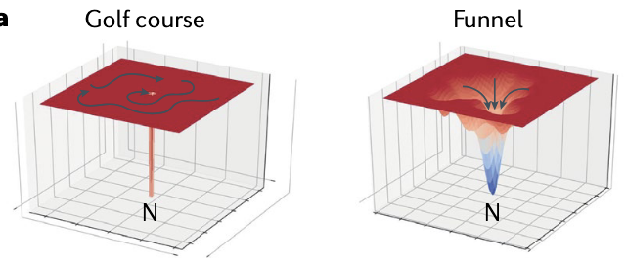
Following Anfinsen and Levinthal down the funnel
Anfinsen’s dogma (or thermodynamic hypothesis) (1960s):
The native structure is at a free energy minimum
Levinthal’s paradox:
How can proteins fold spontaneously if they have so many degrees of freedom?
For 101 residues, there are >3²⁰⁰ different conformations!
Key Insight: Protein folding energy landscape is not shaped like a golf course, but rather a funnel

Slide 8
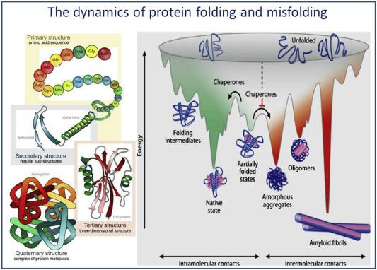
In reality it isn’t one clean funnel
Notes:
In reality ti sn’t one clean funnel. It’s many funnels, and this sets the stage for the “protein folding problem”

Slide 9
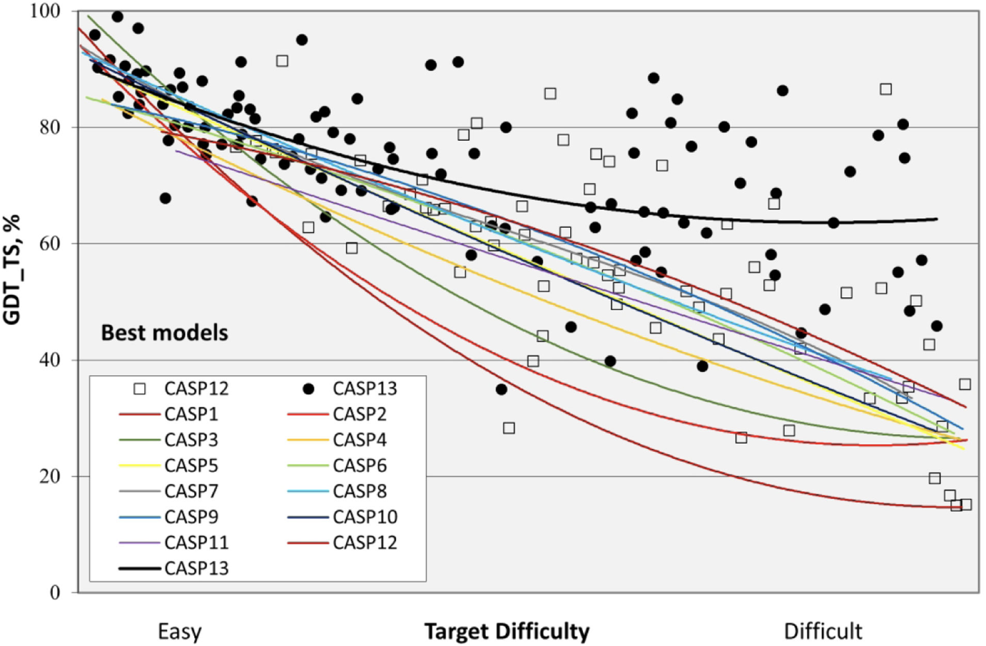
Critical Assessment of protein Structure Prediction (CASP)

Slide 10
Critical Assessment of protein Structure Prediction (CASP)
CASP3 (1998)
Fragment-based assembly

Slide 11
Critical Assessment of protein Structure Prediction (CASP)
CASP3 (1998)
Fragment-based assembly
CASP11 (2014)
Co-evolutionary analysis and deep learning

Slide 12
Critical Assessment of protein Structure Prediction (CASP)
CASP3 (1998)
Fragment-based assembly
CASP11 (2014)
Co-evolutionary analysis and deep learning
CASP13 (2018)
Guiding minimization using deep learning-based potentials
(AlphaFold)

Slide 13
Structure prediction metrics
Metric | Root Mean Squared Deviation (RMSD) | Local Distance Difference Test (lDDT) | Global Distance Test (GDT) | Template Modeling (TM) Score
Units | Å | -- | % | --
Range | > 0 | (0, 1] | (0, 100] | (0, 1]
Length Dependent | Yes | No | Yes | No
Description | Average distance between atoms after superposition | Measures local structural similarity | Measure of global structural similarity | Measure of global structural similarity

Slide 14
Structure prediction metrics
Metric | Root Mean Squared Deviation (RMSD) | Local Distance Difference Test (lDDT) | Global Distance Test (GDT) | Template Modeling (TM) Score
Units | Å | -- | % | --
Range | > 0 | (0, 1] | (0, 100] | (0, 1]
Length Dependent | Yes | No | Yes | No
Description | Average distance between atoms after superposition | Measures local structural similarity | Measure of global structural similarity | Measure of global structural similarity

Slide 15
Structure prediction metrics
Metric | Root Mean Squared Deviation (RMSD) | Local Distance Difference Test (lDDT) | Global Distance Test (GDT) | Template Modeling (TM) Score
Units | Å | -- | % | --
Range | > 0 | (0, 1] | (0, 100] | (0, 1]
Length Dependent | Yes | No | Yes | No
Description | Average distance between atoms after superposition | Measures local structural similarity | Measure of global structural similarity | Measure of global structural similarity

Slide 16
Structure prediction metrics
Metric | Root Mean Squared Deviation (RMSD) | Local Distance Difference Test (lDDT) | Global Distance Test (GDT) | Template Modeling (TM) Score
Units | Å | -- | % | --
Range | > 0 | (0, 1] | (0, 100] | (0, 1]
Length Dependent | Yes | No | Yes | No
Description | Average distance between atoms after superposition | Measures local structural similarity | Measure of global structural similarity | Measure of global structural similarity

Slide 17
Applications
Molecular Replacement
  Predicted protein structures have been used to enhance or fill in experimental structures obtained by techniques like X-ray crystallography, cryo-EM, and NMR spectroscopy.

Slide 18
Applications
Molecular Replacement
  Predicted protein structures have been used to enhance or fill in experimental structures obtained by techniques like X-ray crystallography, cryo-EM, and NMR spectroscopy.
Interpreting experimental results
  Predicted structures of proteins may provide support for experimental findings

Slide 19
Applications
Molecular Replacement
  Predicted protein structures have been used to enhance or fill in experimental structures obtained by techniques like X-ray crystallography, cryo-EM, and NMR spectroscopy.
Interpreting experimental results
  Predicted structures of proteins may provide support for experimental findings
Functional prediction and hypothesis testing
  Enables generation of structure hypotheses related to function and other key properties

Slide 20
Applications
Molecular Replacement
  Predicted protein structures have been used to enhance or fill in experimental structures obtained by techniques like X-ray crystallography, cryo-EM, and NMR spectroscopy.
Interpreting experimental results
  Predicted structures of proteins may provide support for experimental findings
Functional prediction and hypothesis testing
  Enables generation of structure hypotheses related to function and other key properties
Starting point for protein engineering and design

